Slide 1
BMP280 sensor communicate with AWS IoT

Slide 2




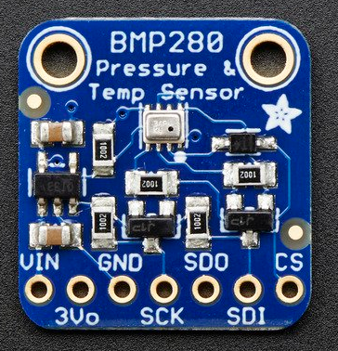

Temperature sensor sample for Android Things with AWS
Environment For Raspberry pi 3 Model B
Devices
Raspberry pi 3 model B
BMP 280
Platform
Android things
Environment For Desktop
OS
Window 10
Software
Android Studio
Android Debug Bridge (ADB)
MQTT
Notes:
Peripheral I/O: communication APIs to sensors and actuators
General Purpose Input/Output(GPIO):
use to read the state of a binary input device and control the on/off state of a binary output device
Adding permission to manifest file
Connect port: in order to open connection to a CPIO port you will using unique GPIO port name to open connection.
Read:
setDirection() with DIRECTION_IN
Current state by getValue()
Close connection: in order to free up resources.
Pulse Width Modulation(PWM): use to control actuators
Serial Communication: use to transfer larger payloads of data between two or more smart devices connected on the same local bus.

Slide 3
Development of temperature sensor send data to AWS IoT
Client certificate and private key: use for connection to AWS IoT
Start Android Studio
Programming
Connect with Android Things Through ADB(Android Debug Bridge)
Execute Application

Slide 4
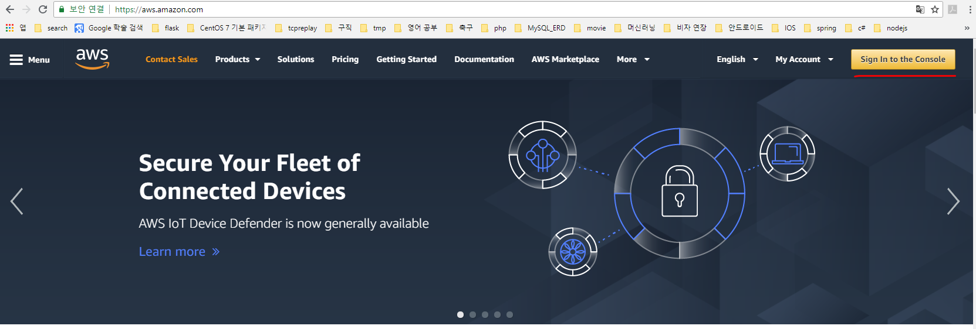
Development of temperature sensor send data to AWS IoT
Cognito Identity with access to AWS IoT
Sign in to the console
Start Android Studio
Programming
Connect with Android Things Through ADB(Android Debug Bridge)
Execute Application

Slide 5
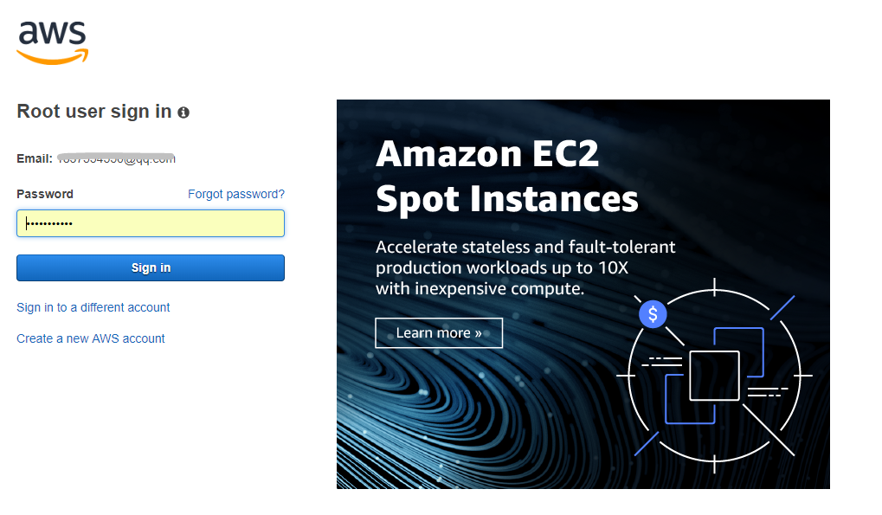
Development of temperature sensor send data to AWS IoT
Cognito Identity with access to AWS IoT
Sign in to the console
Start Android Studio
Programming
Connect with Android Things Through ADB(Android Debug Bridge)
Execute Application

Slide 6
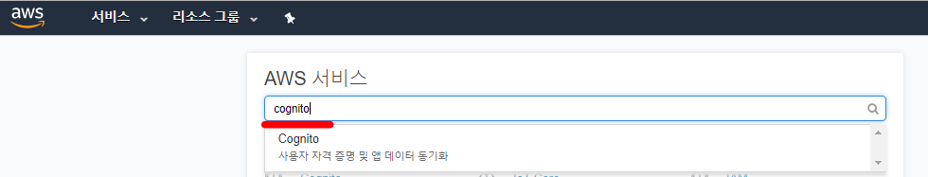
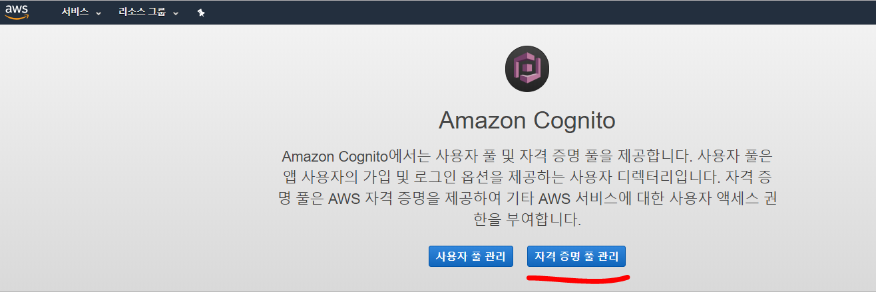
Development of temperature sensor send data to AWS IoT
Cognito Identity with access to AWS IoT
Sign in to the console
Jump to Cognito console
Start Android Studio
Programming
Connect with Android Things Through ADB(Android Debug Bridge)
Execute Application

Slide 7
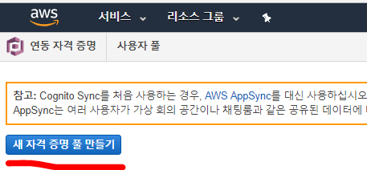
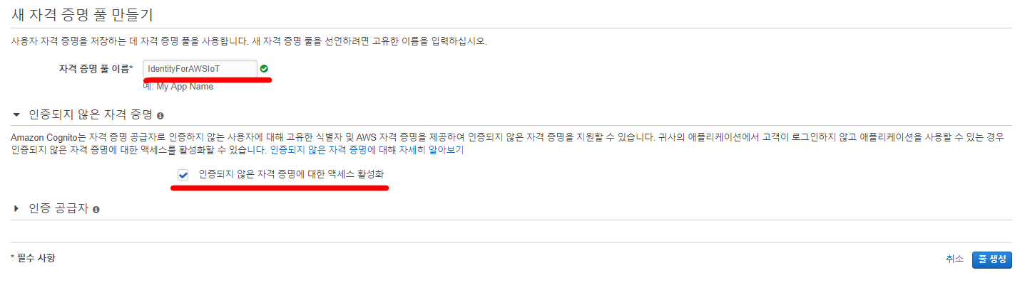
Development of temperature sensor send data to AWS IoT
Cognito Identity with access to AWS IoT
Sign in to the console
Jump to Cognito console
Create new identity pool
Start Android Studio
Programming
Connect with Android Things Through ADB(Android Debug Bridge)
Execute Application

Slide 8
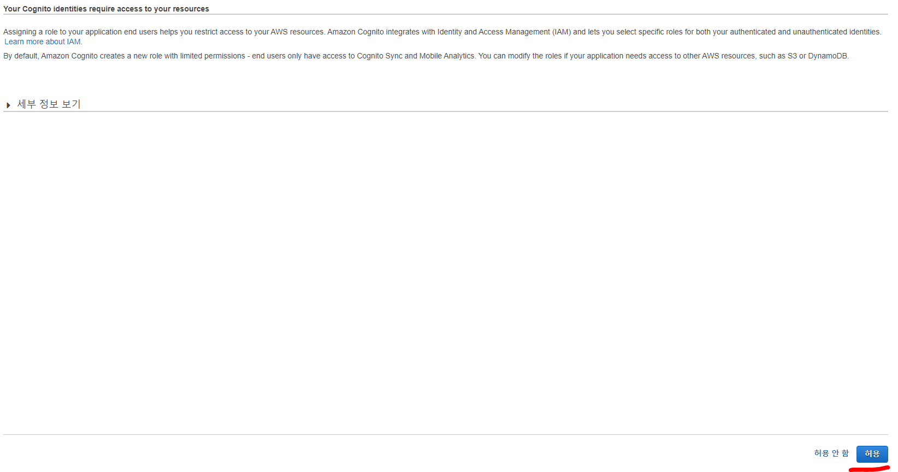
Development of temperature sensor send data to AWS IoT
Cognito Identity with access to AWS IoT
Sign in to the console
Jump to Cognito console
Create new identity pool
Start Android Studio
Programming
Connect with Android Things Through ADB(Android Debug Bridge)
Execute Application

Slide 9
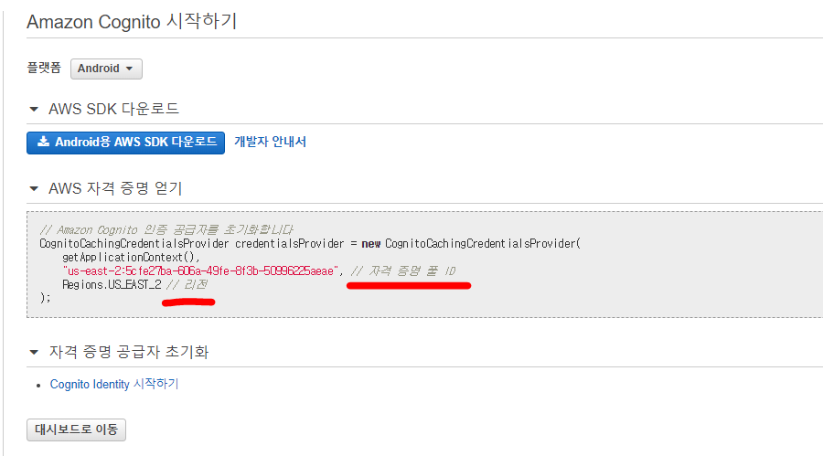
Development of temperature sensor send data to AWS IoT
Cognito Identity with access to AWS IoT
Sign in to the console
Jump to Cognito console
Create new identity pool
Note down identity pool ID and Region.
Start Android Studio
Programming
Connect with Android Things Through ADB(Android Debug Bridge)
Execute Application

Slide 10
Development of temperature sensor send data to AWS IoT
Cognito Identity with access to AWS IoT
Sign in to the console
Jump to Cognito console
Create new identity pool
Note down identity pool ID and Region.
Start Android Studio
Programming
Connect with Android Things Through ADB(Android Debug Bridge)
Execute Application

Slide 11
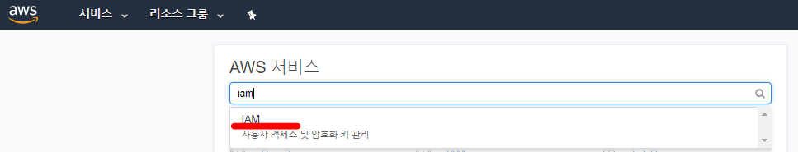
Development of temperature sensor send data to AWS IoT
Cognito Identity with access to AWS IoT
Sign in to the console
Jump to Cognito console
Create new identity pool
Note down identity pool ID and Region.
Setup permissions for access the AWS IoT APIs in Identity and Access Management(IAM) console
Start Android Studio
Programming
Connect with Android Things Through ADB(Android Debug Bridge)
Execute Application

Slide 12
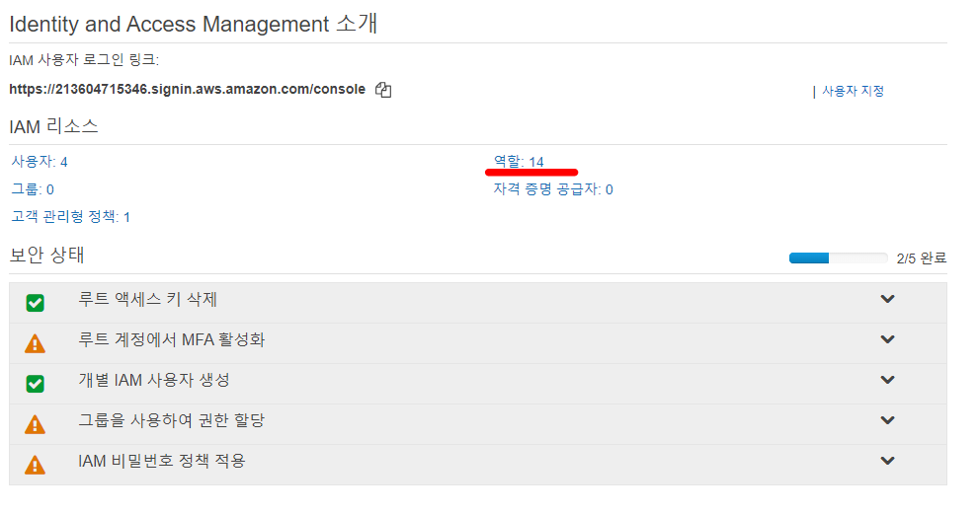
Development of temperature sensor send data to AWS IoT
Cognito Identity with access to AWS IoT
Sign in to the console
Jump to Cognito console
Create new identity pool
Note down identity pool ID and Region.
Setup permissions for access the AWS IoT APIs in Identity and Access Management(IAM) console
Start Android Studio
Programming
Connect with Android Things Through ADB(Android Debug Bridge)
Execute Application

Slide 13
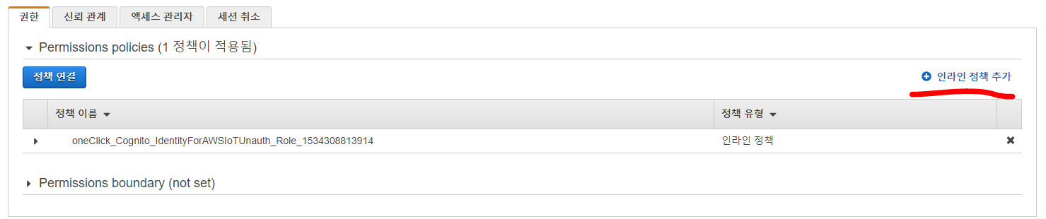
Development of temperature sensor send data to AWS IoT
Cognito Identity with access to AWS IoT
Sign in to the console
Jump to Cognito console
Create new identity pool
Note down identity pool ID and Region.
Setup permissions for access the AWS IoT APIs in Identity and Access Management(IAM) console
Start Android Studio
Programming
Connect with Android Things Through ADB(Android Debug Bridge)
Execute Application

Slide 14
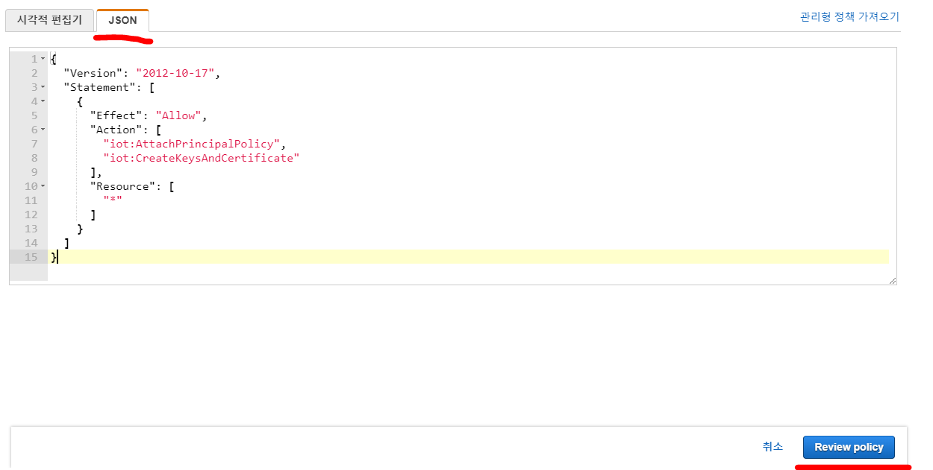
Development of temperature sensor send data to AWS IoT
Cognito Identity with access to AWS IoT
Sign in to the console
Jump to Cognito console
Create new identity pool
Note down identity pool ID and Region.
Setup permissions for access the AWS IoT APIs in Identity and Access Management(IAM) console
Start Android Studio
Programming
Connect with Android Things Through ADB(Android Debug Bridge)
Execute Application

Slide 15
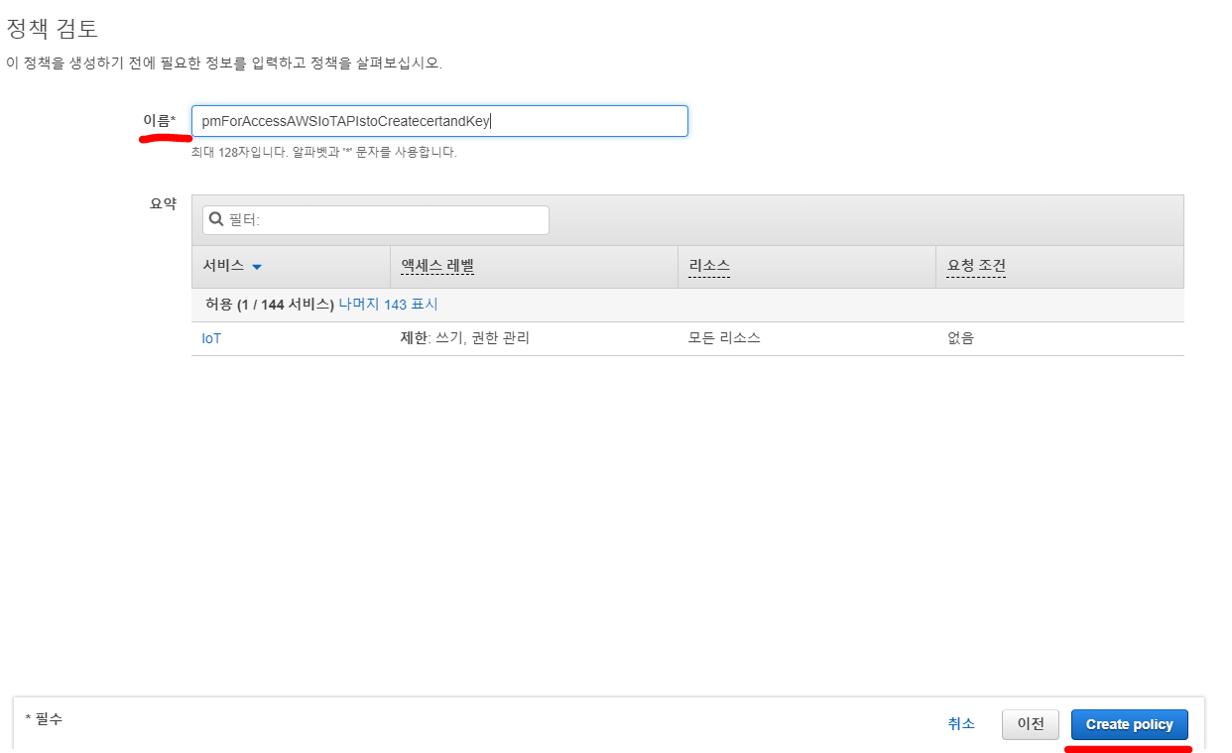
Development of temperature sensor send data to AWS IoT
Cognito Identity with access to AWS IoT
Sign in to the console
Jump to Cognito console
Create new identity pool
Note down identity pool ID and Region.
Setup permissions for access the AWS IoT APIs in Identity and Access Management(IAM) console
Start Android Studio
Programming
Connect with Android Things Through ADB(Android Debug Bridge)
Execute Application

Slide 16
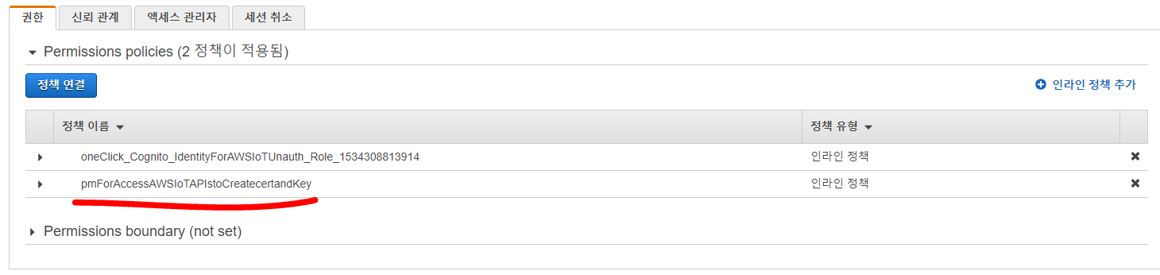
Development of temperature sensor send data to AWS IoT
Cognito Identity with access to AWS IoT
Sign in to the console
Jump to Cognito console
Create new identity pool
Note down identity pool ID and Region.
Setup permissions for access the AWS IoT APIs in Identity and Access Management(IAM) console
Start Android Studio
Programming
Connect with Android Things Through ADB(Android Debug Bridge)
Execute Application

Slide 17
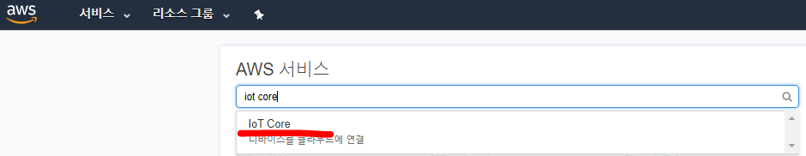
Development of temperature sensor send data to AWS IoT
Cognito Identity with access to AWS IoT
Sign in to the console
Jump to Cognito console
Create new identity pool
Note down identity pool ID and Region.
Setup permissions for access the AWS IoT APIs in Identity and Access Management(IAM) console
Create policy for pub/sub message on AWS IoT platform
Start Android Studio
Programming
Connect with Android Things Through ADB(Android Debug Bridge)
Execute Application

Slide 18
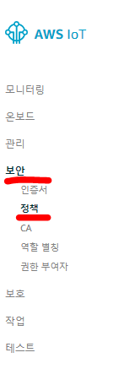
Development of temperature sensor send data to AWS IoT
Cognito Identity with access to AWS IoT
Sign in to the console
Jump to Cognito console
Create new identity pool
Note down identity pool ID and Region.
Setup permissions for access the AWS IoT APIs in Identity and Access Management(IAM) console
Create policy for pub/sub message on AWS IoT platform
Start Android Studio
Programming
Connect with Android Things Through ADB(Android Debug Bridge)
Execute Application

Slide 19
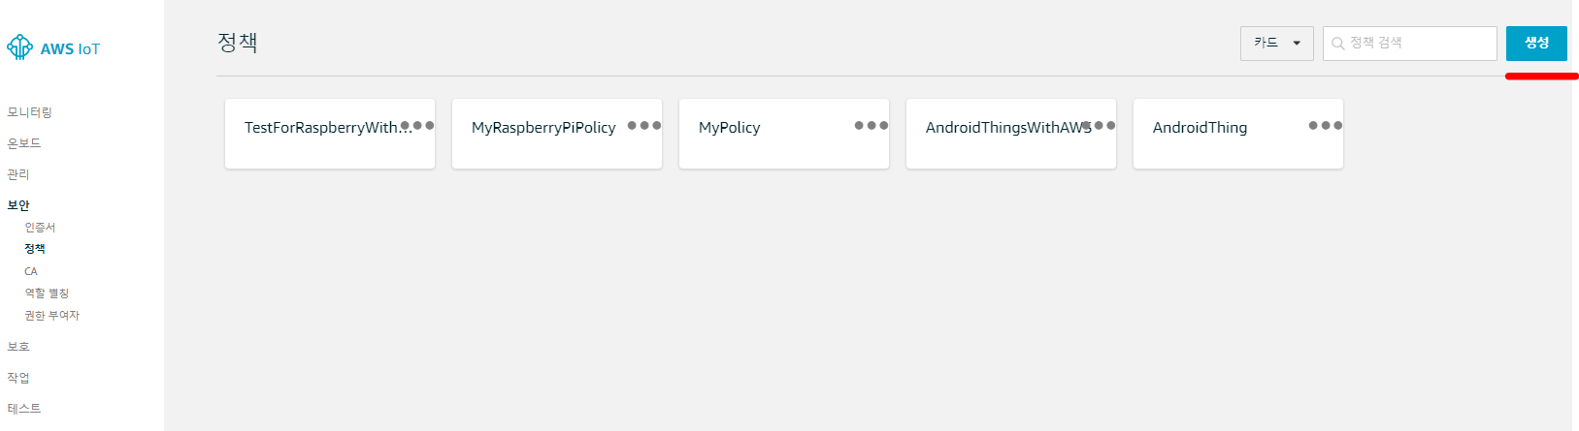
Development of temperature sensor send data to AWS IoT
Cognito Identity with access to AWS IoT
Sign in to the console
Jump to Cognito console
Create new identity pool
Note down identity pool ID and Region.
Setup permissions for access the AWS IoT APIs in Identity and Access Management(IAM) console
Create policy for pub/sub message on AWS IoT platform
Start Android Studio
Programming
Connect with Android Things Through ADB(Android Debug Bridge)
Execute Application

Slide 20
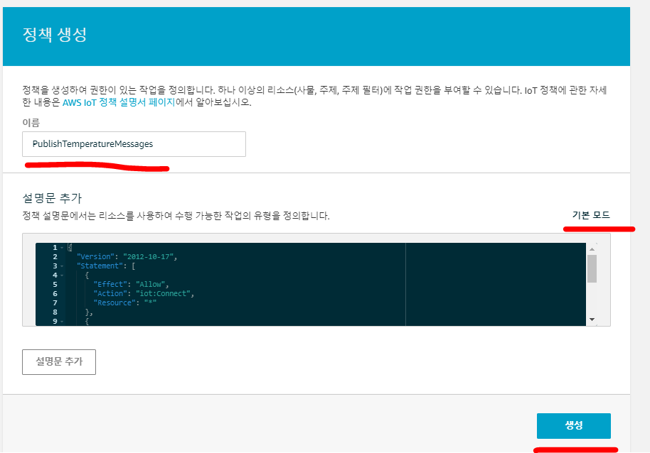
Development of temperature sensor send data to AWS IoT
Cognito Identity with access to AWS IoT
Sign in to the console
Jump to Cognito console
Create new identity pool
Note down identity pool ID and Region.
Setup permissions for access the AWS IoT APIs in Identity and Access Management(IAM) console
Create policy for pub/sub message on AWS IoT platform
Start Android Studio
Programming
Connect with Android Things Through ADB(Android Debug Bridge)
Execute Application
{ "Version": "2012-10-17",
"Statement": [
{
"Effect": "Allow", "Action": "iot:Connect", "Resource": "*“
}, {
"Effect": "Allow", "Action": [
"iot:Publish", "iot:Subscribe", "iot:Receive“
],
"Resource": "*" }
]
}

Slide 21
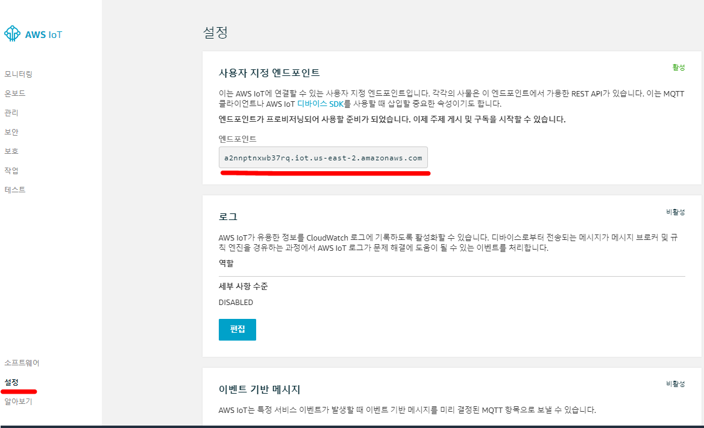
Development of temperature sensor send data to AWS IoT
Cognito Identity with access to AWS IoT
Sign in to the console
Jump to Cognito console
Create new identity pool
Note down identity pool ID and Region.
Setup permissions for access the AWS IoT APIs in Identity and Access Management(IAM) console
Create policy for pub/sub message on AWS IoT platform
Note down endpoint
Start Android Studio
Programming
Connect with Android Things Through ADB(Android Debug Bridge)
Execute Application

Slide 22
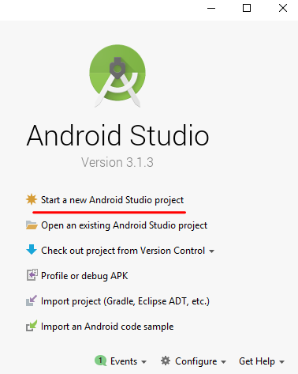
Development of temperature sensor send data to AWS IoT
Client certificate and private key: use for connection to AWS IoT
Start Android Studio
Start a new Android Studio project
Programming
Connect with Android Things Through ADB(Android Debug Bridge)
Execute Application

Slide 23
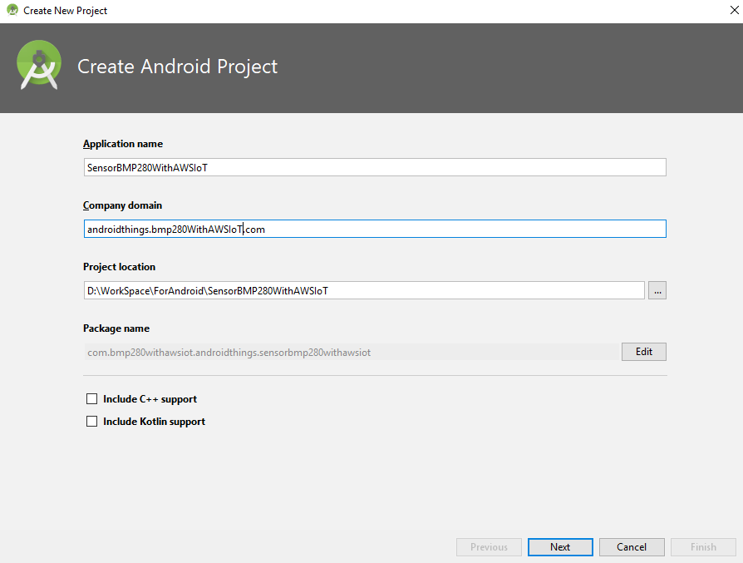
Development of temperature sensor send data to AWS IoT
Client certificate and private key: use for connection to AWS IoT
Start Android Studio
Start a new Android Studio project
Set information
Programming
Connect with Android Things Through ADB(Android Debug Bridge)
Execute Application

Slide 24
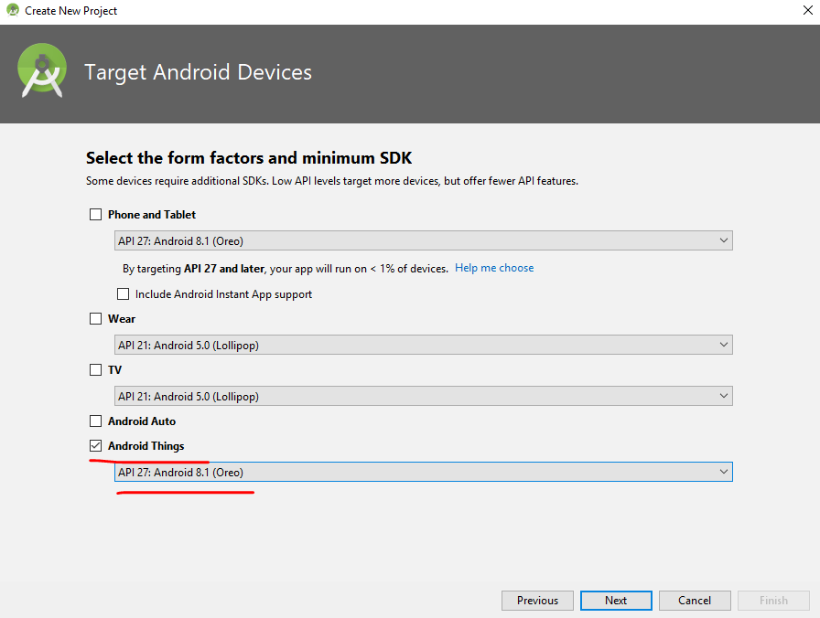
Development of temperature sensor send data to AWS IoT
Client certificate and private key: use for connection to AWS IoT
Start Android Studio
Start a new Android Studio project
Set information
Choose device and Android things version
Programming
Connect with Android Things Through ADB(Android Debug Bridge)
Execute Application

Slide 25
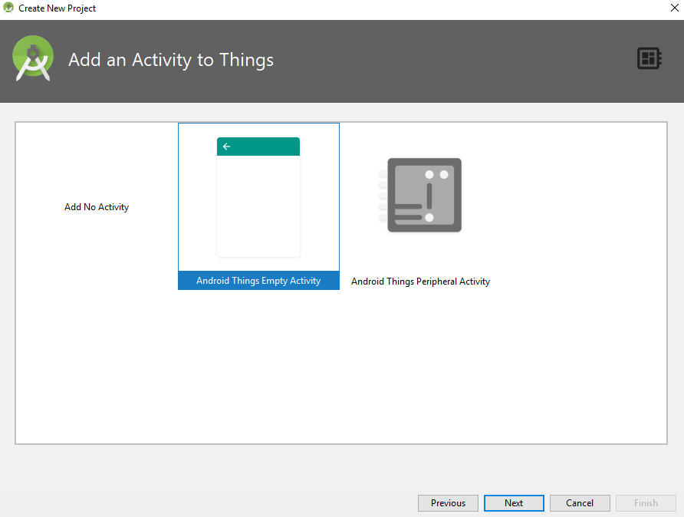
Development of temperature sensor send data to AWS IoT
Client certificate and private key: use for connection to AWS IoT
Start Android Studio
Start a new Android Studio project
Set information
Choose device and Android things version
Add Activity: default
Programming
Connect with Android Things Through ADB(Android Debug Bridge)
Execute Application

Slide 26
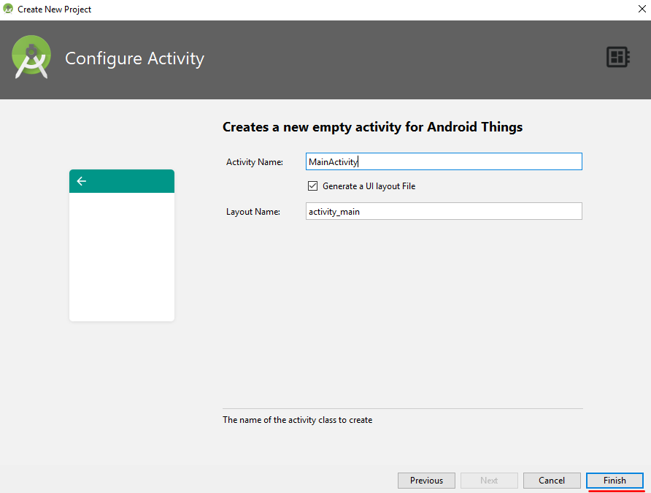
Development of temperature sensor send data to AWS IoT
Client certificate and private key: use for connection to AWS IoT
Start Android Studio
Start a new Android Studio project
Set information
Choose device and Android things version
Add Activity: default
Configure Activity: default
Programming
Connect with Android Things Through ADB(Android Debug Bridge)
Execute Application

Slide 27
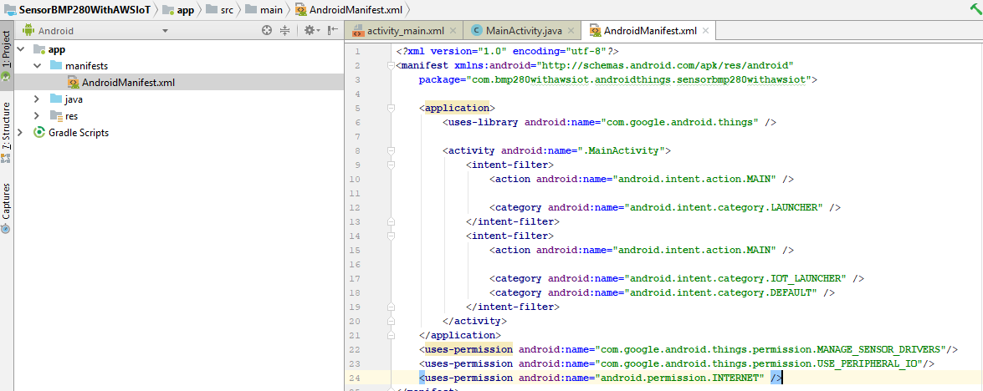
Development of temperature sensor send data to AWS IoT
Client certificate and private key: use for connection to AWS IoT
Start Android Studio
Programming
Add permission
Connect with Android Things Through ADB(Android Debug Bridge)
Execute Application

Slide 28
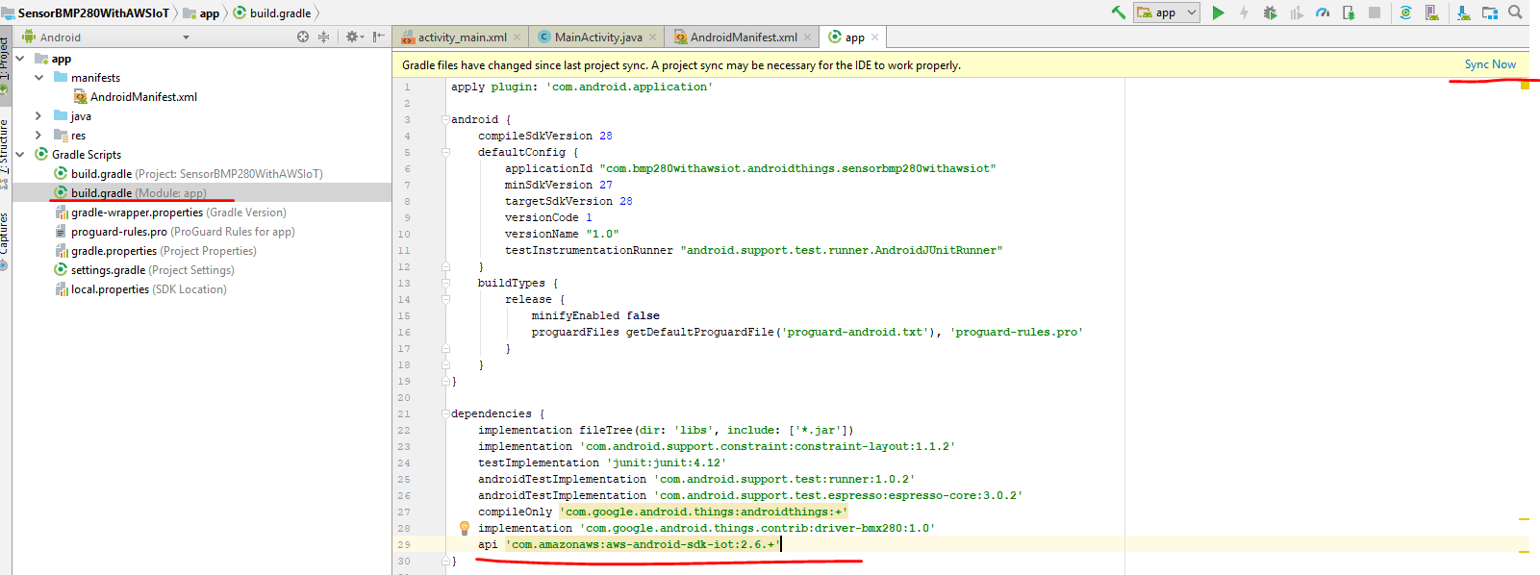
Development of temperature sensor send data to AWS IoT
Client certificate and private key: use for connection to AWS IoT
Start Android Studio
Programming
Add permission
Add dependencies
Connect with Android Things Through ADB(Android Debug Bridge)
Execute Application

Slide 29
Development of temperature sensor send data to AWS IoT
Client certificate and private key: use for connection to AWS IoT
Start Android Studio
Programming
Add permission
Add dependencies
Add code
Add methods in MainActivity
Configure constants
Connect with Android Things Through ADB(Android Debug Bridge)
Execute Application
// IoT endpoint // AWS Iot CLI describe-endpoint call returns: XXXXXXXXXX.iot.<region>.amazonaws.com private static final String CUSTOMER_SPECIFIC_ENDPOINT = "a2nnptnxwb37rq.iot.us-east-2.amazonaws.com"; // Cognito pool ID. For this app, pool needs to be unauthenticated pool with // AWS IoT permissions. private static final String COGNITO_POOL_ID = "us-east-2:5cfe27ba-606a-49fe-8f3b-50996225aeae"; // Name of the AWS IoT policy to attach to a newly created certificate private static final String AWS_IOT_POLICY_NAME = "PublishTemperatureMessages"; // Region of AWS IoT private static final Regions MY_REGION = Regions.US_EAST_2; // Filename of KeyStore file on the filesystem private static final String KEYSTORE_NAME = "iot_keystore"; // Password for the private key in the KeyStore private static final String KEYSTORE_PASSWORD = "123"; // Certificate and key aliases in the KeyStore private static final String CERTIFICATE_ID = "cert1";

Slide 30
Development of temperature sensor send data to AWS IoT
Client certificate and private key: use for connection to AWS IoT
Start Android Studio
Programming
Add permission
Add dependencies
Add code
Add methods in MainActivity
Estabilish connection with BMP280 sensor
Connect with Android Things Through ADB(Android Debug Bridge)
Execute Application
public void connectWithSonser(){ try { mBmx280 = new Bmx280(“I2C1”); // Configure driver settings mBmx280.setTemperatureOversampling(Bmx280.OVERSAMPLING_1X); // wake up sensor mBmx280.setMode(Bmx280.MODE_NORMAL); Log.i(TAG,"connect with sensor"); } catch (IOException e) { Log.i(TAG,"connect error with sensor"); } }

Slide 31
Development of temperature sensor send data to AWS IoT
Client certificate and private key: use for connection to AWS IoT
Start Android Studio
Programming
Add permission
Add dependencies
Add code
Add methods in MainActivity
Initialize mqtt manager, AWSIotClient
Connect with Android Things Through ADB(Android Debug Bridge)
Execute Application
clientId = "myAWSIoTClient"; // Initialize the AWS Cognito credentials provider credentialsProvider = new CognitoCachingCredentialsProvider( getApplicationContext(), // context COGNITO_POOL_ID, // Identity Pool ID MY_REGION // Region ); Region region = Region.getRegion(MY_REGION); // MQTT Client mqttManager = new AWSIotMqttManager(clientId, CUSTOMER_SPECIFIC_ENDPOINT); // Set keepalive to 10 seconds. Will recognize disconnects more quickly but will also send // MQTT pings every 10 seconds. mqttManager.setKeepAlive(10); // Set Last Will and Testament for MQTT. On an unclean disconnect (loss of connection) // AWS IoT will publish this message to alert other clients. AWSIotMqttLastWillAndTestament lwt = new AWSIotMqttLastWillAndTestament("my/lwt/topic", "Android client lost connection", AWSIotMqttQos.QOS0); mqttManager.setMqttLastWillAndTestament(lwt); // IoT Client (for creation of certificate if needed) mIotAndroidClient = new AWSIotClient(credentialsProvider); mIotAndroidClient.setRegion(region); keystorePath = getFilesDir().getPath(); keystoreName = KEYSTORE_NAME; keystorePassword = KEYSTORE_PASSWORD; certificateId = CERTIFICATE_ID;

Slide 32
Development of temperature sensor send data to AWS IoT
Client certificate and private key: use for connection to AWS IoT
Start Android Studio
Programming
Add permission
Add dependencies
Add code
Add methods in MainActivity
Load certificate and private key from local filesystem
Connect with Android Things Through ADB(Android Debug Bridge)
Execute Application
// To load cert/key from keystore on filesystem try { if (AWSIotKeystoreHelper.isKeystorePresent(keystorePath, keystoreName)) { if (AWSIotKeystoreHelper.keystoreContainsAlias(certificateId, keystorePath, keystoreName, keystorePassword)) { Log.i(LOG_TAG, "Certificate " + certificateId + " found in keystore - using for MQTT."); // load keystore from file into memory to pass on connection clientKeyStore = AWSIotKeystoreHelper.getIotKeystore(certificateId, keystorePath, keystoreName, keystorePassword); } else { Log.i(LOG_TAG, "Key/cert " + certificateId + " not found in keystore."); } } else { Log.i(LOG_TAG, "Keystore " + keystorePath + "/" + keystoreName + " not found."); } } catch (Exception e) { Log.e(LOG_TAG, "An error occurred retrieving cert/key from keystore.", e); }

Slide 33
Development of temperature sensor send data to AWS IoT
Client certificate and private key: use for connection to AWS IoT
Start Android Studio
Programming
Add permission
Add dependencies
Add code
Add methods in MainActivity
Create certificate and private key to local filesystem
Connect with Android Things Through ADB(Android Debug Bridge)
Execute Application
if (clientKeyStore == null) { Log.i(LOG_TAG, "Cert/key was not found in keystore - creating new key and certificate."); try { CreateKeysAndCertificateRequest createKeysAndCertificateRequest = new CreateKeysAndCertificateRequest(); createKeysAndCertificateRequest.setSetAsActive(true); final CreateKeysAndCertificateResult createKeysAndCertificateResult; createKeysAndCertificateResult = mIotAndroidClient.createKeysAndCertificate(createKeysAndCertificateRequest); Log.i(LOG_TAG, "Cert ID: " + createKeysAndCertificateResult.getCertificateId() + " created."); AWSIotKeystoreHelper.saveCertificateAndPrivateKey(certificateId, createKeysAndCertificateResult.getCertificatePem(), createKeysAndCertificateResult.getKeyPair().getPrivateKey(), keystorePath, keystoreName, keystorePassword); clientKeyStore = AWSIotKeystoreHelper.getIotKeystore(certificateId, keystorePath, keystoreName, keystorePassword); AttachPrincipalPolicyRequest policyAttachRequest = new AttachPrincipalPolicyRequest(); policyAttachRequest.setPolicyName(AWS_IOT_POLICY_NAME); policyAttachRequest.setPrincipal(createKeysAndCertificateResult .getCertificateArn()); mIotAndroidClient.attachPrincipalPolicy(policyAttachRequest); } catch (Exception e) { Log.e(LOG_TAG, "Exception occurred when generating new private key and certificate.", e); } }

Slide 34
Development of temperature sensor send data to AWS IoT
Client certificate and private key: use for connection to AWS IoT
Start Android Studio
Programming
Add permission
Add dependencies
Add code
Add methods in MainActivity
Connect with AWS IoT
Connect with Android Things Through ADB(Android Debug Bridge)
Execute Application
try { mqttManager.connect(clientKeyStore, new AWSIotMqttClientStatusCallback() { @Override public void onStatusChanged(final AWSIotMqttClientStatus status, final Throwable throwable) { Log.d(LOG_TAG, "Status = " + String.valueOf(status)); runOnUiThread(new Runnable() { @Override public void run() { if (status == AWSIotMqttClientStatus.Connecting) { Log.i(LOG_TAG,"Connecting..."); } else if (status == AWSIotMqttClientStatus.Connected) { Log.i(LOG_TAG,"Connected"); } else if (status == AWSIotMqttClientStatus.Reconnecting) { if (throwable != null) { Log.e(LOG_TAG, "Connection error.", throwable); } Log.i(LOG_TAG,"Reconnecting"); } else if (status == AWSIotMqttClientStatus.ConnectionLost) { if (throwable != null) { Log.e(LOG_TAG, "Connection error.", throwable); } Log.i(LOG_TAG,"Disconnected"); } else { Log.i(LOG_TAG,"Disconnected"); } } }); } }); } catch (final Exception e) { Log.e(LOG_TAG, "Connection error.", e); Log.i(LOG_TAG,"Error! " + e.getMessage()); }

Slide 35
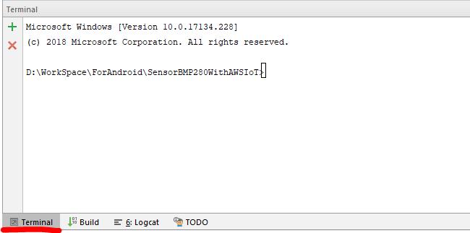
Development of temperature sensor send data to AWS IoT
Client certificate and private key: use for connection to AWS IoT
Start Android Studio
Programming
Connect with Android Things Through ADB(Android Debug Bridge)
Start terminal
Execute Application
Notes:
Problem
adb is not recognized as an internal or external command
Resolution
set environment variable to path
Click start
Type edit environment variables for your account
Double Click path
Click new
Paste that path in
adb tool is located in C:\Users\[your user name]\AppData\Local\Android\sdk\platform-tools by default

Slide 36
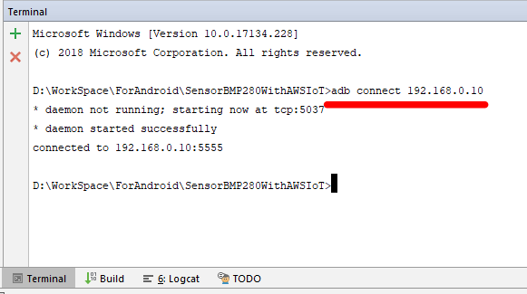
Development of temperature sensor send data to AWS IoT
Client certificate and private key: use for connection to AWS IoT
Start Android Studio
Programming
Connect with Android Things Through ADB(Android Debug Bridge)
Start terminal
Connect to device
Execute Application

Slide 37
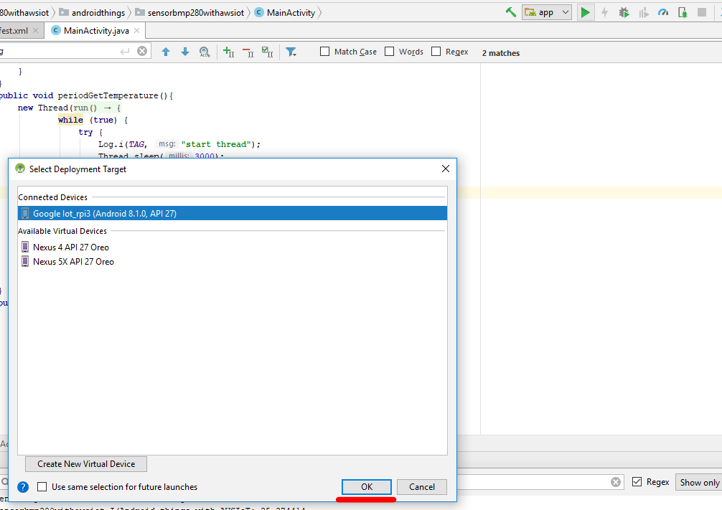
Development of temperature sensor send data to AWS IoT
Client certificate and private key: use for connection to AWS IoT
Start Android Studio
Programming
Connect with Android Things Through ADB(Android Debug Bridge)
Execute Application

Slide 38
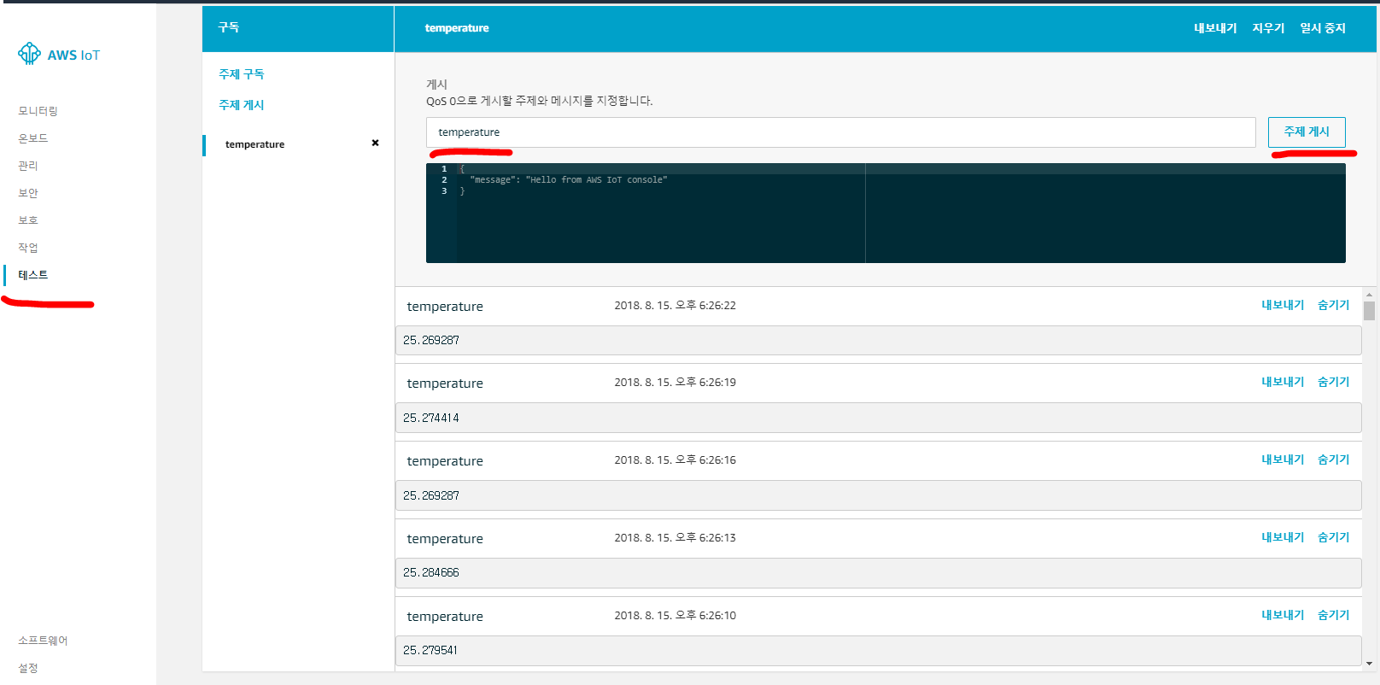
Development of temperature sensor send data to AWS IoT
Client certificate and private key: use for connection to AWS IoT
Start Android Studio
Programming
Connect with Android Things Through ADB(Android Debug Bridge)
Execute Application

Slide 39
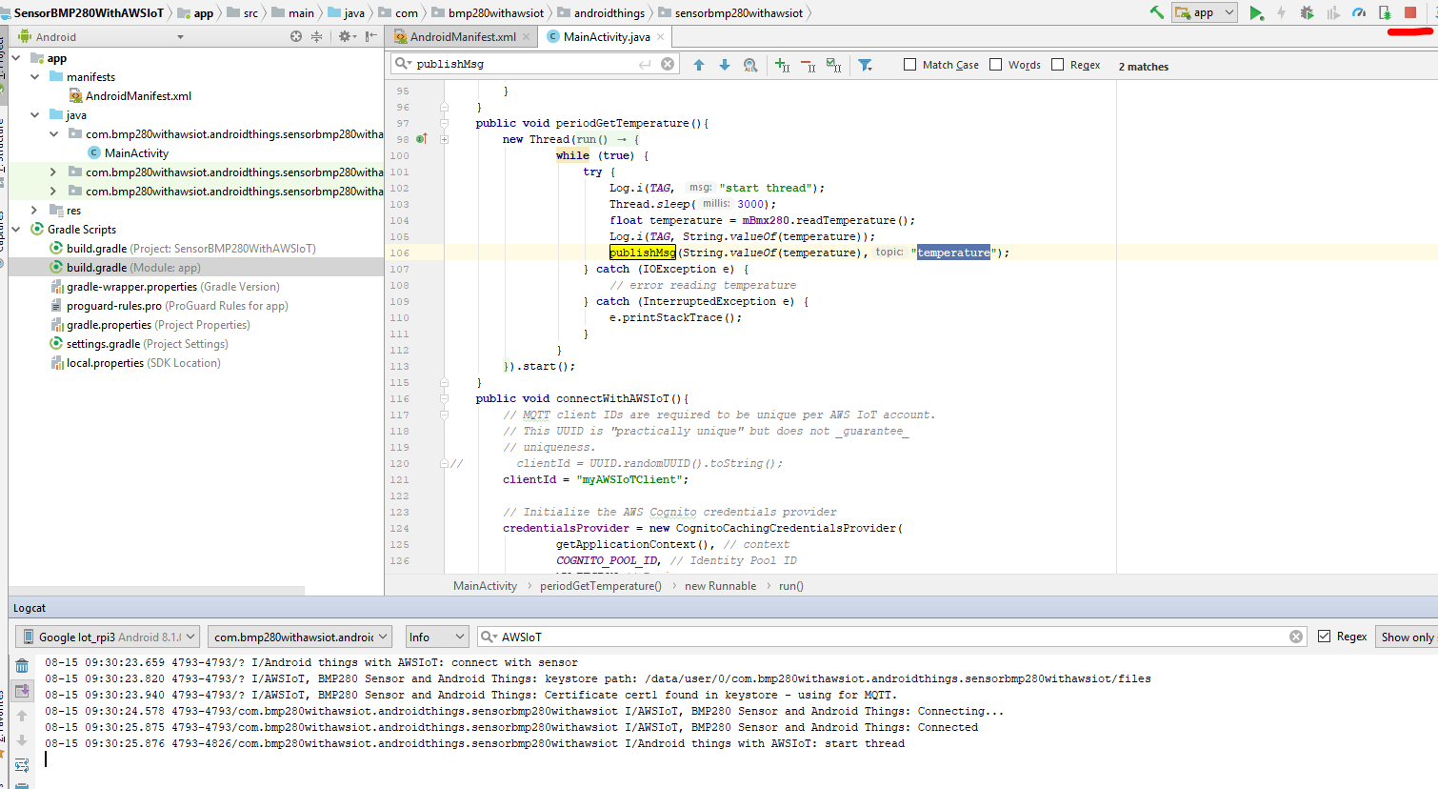
Development of temperature sensor send data to AWS IoT
Client certificate and private key: use for connection to AWS IoT
Start Android Studio
Programming
Connect with Android Things Through ADB(Android Debug Bridge)
Execute Application
Stop

Slide 40
Reference
https://aws.amazon.com/mobile/resources/
https://github.com/awslabs/aws-sdk-android-samples
https://github.com/awslabs/aws-sdk-android-samples/blob/master/AndroidPubSub/README.md
https://github.com/androidthings/drivers-samples/tree/master/bmx280
https://github.com/androidthings/contrib-drivers/tree/master/bmx280

